Slide 1

Azure Developer – Virtual Mentored Program
Microservices, Kubernetes, and Azure Kubernetes Service (AKS)

Slide 2
Week 5 Content
Microservices
Kubernetes
Azure Kubernetes Service (AKS)

Slide 3
Microservices & Containerization as a Deployment Strategy

Slide 4
Why Containerization?
Abstracts away the code implementation so you can deploy in a platform-agnostic manner, writing in the language of your choice
Aligns strongly with the principles and practices of DevOps
Helps leverage the power of the cloud
Speeds up important non-coding activities (infrastructure spin-up, testing, CI/CD tasks, DevSecOps, code quality checks, etc.
Helps breed consistency vs. “snowflake”
Notes:
[Mandatory slide]
ACTION: Adjust as per your course.
The “Why?” and the “What’s in it for me?” are key to setting the stage for the course and getting students primed to learn. It is a good practice to use a “Why?” slide before each new topic or module that is going to be taught.

Slide 5
What Do We Mean by Application Hosting?
The target infrastructure and runtime platform that will be employed for deployment and execution of an application or system
Can include compute (CPU and server resources), storage, network, data and operating system
Notes:
Reminder – covered in Working with Cloud

Slide 6
What Are the Hosting Options with Cloud?
IaaS
PaaS
Serverless / FaaS
SaaS
Containers
Notes:
Reminder – covered in Working with Cloud

Slide 7
Containers
Form of virtualization at the app packaging level (like virtual machines at the server level)
Isolated from one another at the OS process layer (vs VM’s which are isolated at the hardware abstraction layer)
Images represent the packaging up of an application and its dependencies as a complete, deployable unit of execution (code, runtime and configuration)
Notes:
What are virtual machines? Virtual (vs. physical) computers built using images that support independent execution of and interaction with an instance built from the image and running against a “slice” of the physical host’s resources. Multiple VM instances can be run on the same physical host at the same time and are managed by a program called a hypervisor.
Containers are isolated from one another at the OS process layer (vs VM’s which are isolated at the hardware abstraction layer)

Slide 8
Containers
A platform (e.g., Docker) running on a system can be used to dynamically create containers (executable instances of the app) from the defined image
Typically, much, much smaller than a VM which makes them lightweight, quickly deployable and quick to “boot up”
An orchestration engine (e.g., Kubernetes) might be used to coordinate multiple instances of the same container (or a “pod” of containers) to enable the servicing of more concurrent requests (scalability)

Slide 9
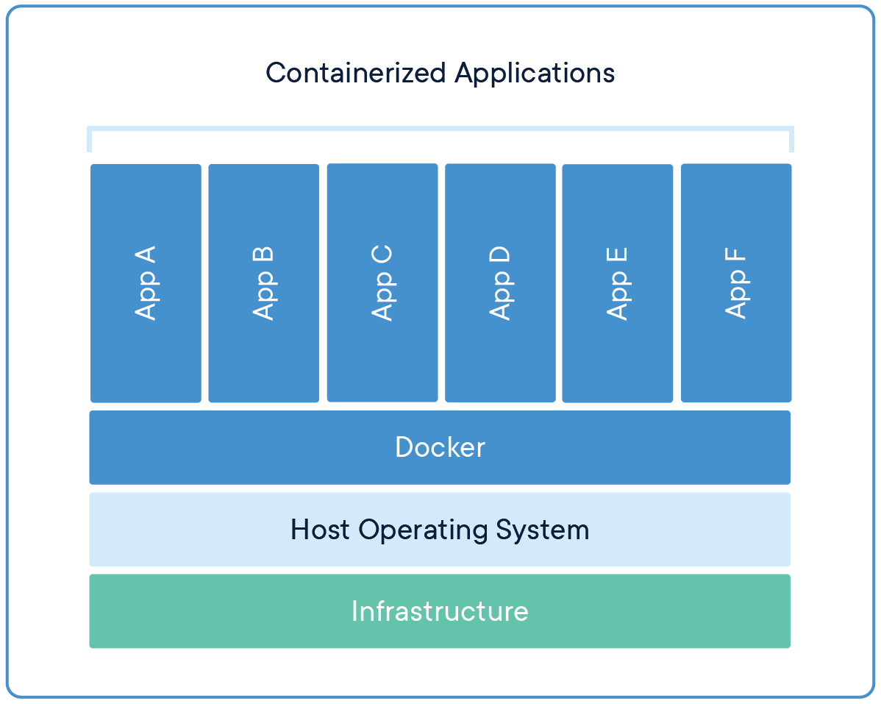
Containers

Slide 10
What are Microservices?
An architectural style in which a distributed application is created as a collection of services that are:
Highly maintainable and testable
Loosely coupled
Independently deployable (by extension, independently-scalable)
Domain centric and organized around business capabilities
The Microservices architecture enables the continuous deployment and delivery of large, complex distributed applications

Slide 11
What is a Monolith?
Typical enterprise application
Large codebases
Set technology stack
Highly coupled elements
Whole system affected by failures
Scaling requires the duplication of the entire app
Minor changes often require full rebuild

Slide 12
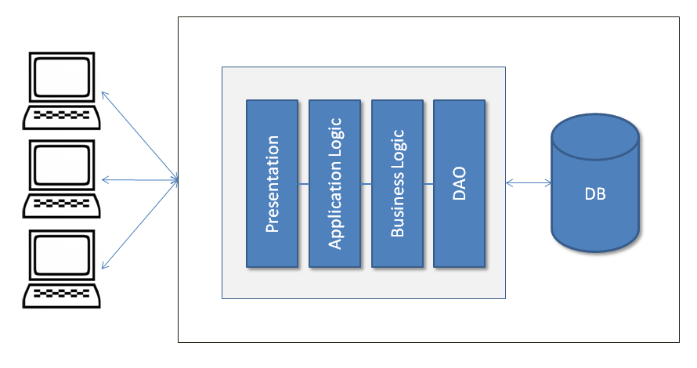
Monolithic Architecture Example

Slide 13
Moving to Microservices
We have moved towards a refinement of “what is a service?”
Even in SOA, we can create a service that does more than one thing – using it to solve an overall business problem, rather than one part of the actions needed to solve that problem
This was moving us back towards monolithic
We arrive at a point where we want individual, purposeful services that do one thing and do it well – the microservice

Slide 14
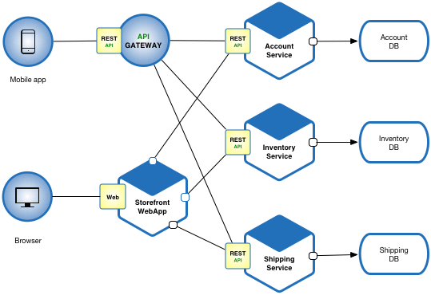
Example Microservices Architecture

Slide 15
Microservices – Benefits vs. Costs
Benefits:
Enables work in parallel
Promotes organization according to business domain
Advantages from isolation
Flexible in terms of deployment and scale
Flexible in terms of technology

Slide 16
Microservices – Benefits vs. Costs
Costs:
Requires a different way of thinking
Complexity moves to the integration layer
Organization needs to be able to support re-org according to business domain (instead of technology domain)
With an increased reliance on the network, you may encounter latency and failures at the network layer
Transactions must be handled differently (across service boundaries)
Notes:
Mention Conway’s Law
Talk about new customer operation with initial deposit – those operations need to happen transactionally

Slide 17
Microservices & Containers
Microservices – with their smaller size, independently-deployable and independently-scalable profile, and encapsulated business domain boundary – are a great fit for containers
Using Kubernetes, sophisticated systems of integrated microservices can be built, tested and deployed
Leveraging the scheduling and scalability benefits of Kubernetes can help an organization target scaling across a complex workflow in very granular ways
This helps with cost management as you can toggle individual parts of the system for optimized performance

Slide 18
Microservices & the Cloud
Microservices have broad support across multiple Cloud providers
One option includes standing up VM’s (IaaS) and installing / managing a Kubernetes cluster on those machines or
Another option includes leveraging a managed service (PaaS) provided by the CSP
Microservices are a great option for the Cloud because the elastic scalability provided by the Cloud infrastructure can directly support the independent scalability needed with a microservices architecture

Slide 19
Microservices Summary
Applications that can
Efficiently scale
Are flexible
Are high performance
These apps are powered by multiple services, working in concert
Each service is small and has a single focus
We use a lightweight communication mechanism to coordinate the overall system
This ends up giving us a technology agnostic API

Slide 20
Kubernetes and Container Orchestration

Slide 21
Kubernetes (k8s) Overview
Kubernetes is a portable, extensible, open-source platform for managing containerized workloads and services

Slide 22
What is an Orchestrator and Why Do We Need It?
What would it look like to manually control the containers needed for your application as your app scales or containers fail?
“Orchestration” is the execution of a defined workflow
We can use an orchestrator to start and stop containers automatically based on your set rules
What does this open up for you?

Slide 23
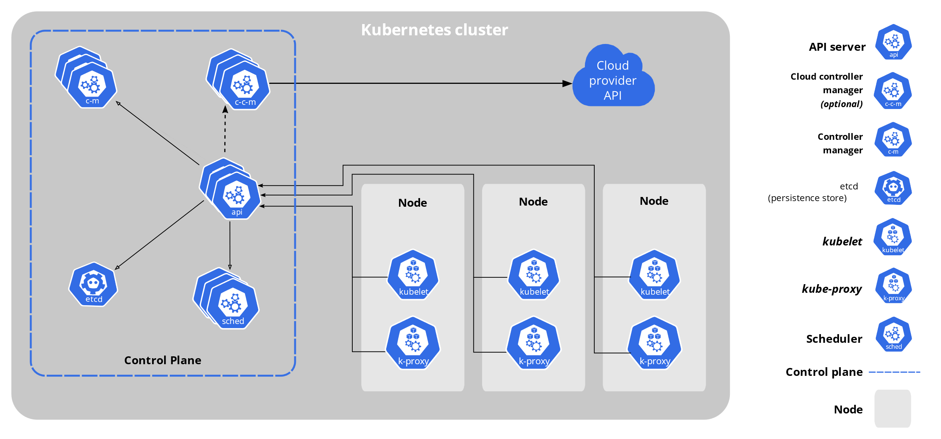
Architecture of k8s System

Slide 24
Core Components of k8s
When you deploy Kubernetes, you get a cluster.
A Kubernetes cluster consists of a set of worker machines, called nodes, that run containerized applications. Every cluster has at least one worker node.
The worker node(s) host the Pods that are the components of the application workload.
The control plane manages the worker nodes and the Pods in the cluster.

Slide 25
k8s Resource/Manifest
Kubernetes manifests are text files, usually written in YAML
They are used to create, modify and delete Kubernetes resources

Slide 26
Declarative and Desired State
Kubernetes supports a declarative model – we can send the api a yaml file in a declarative form
Desired state means that we specify in the yaml file our desired state and the cluster takes responsibility to make sure it will happen
We describe the desired state using a yaml or json file that serves as a record of intent, but we do not specify how to get there (this is kubernetes responsibility to get us there)
Things could change or go wrong over the lifetime of the cluster (node failing, etc…), Kubernetes is responsible to always make sure that the desired state is kept intact
Kubernetes control plane controllers are always running in a loop and checking that the actual state of the cluster matches the desired state, so that if any error occurs they kick in and rectify the cluster

Slide 27
k8s Pods: The Basic Building Block
A pod represents a set of running containers in your cluster
Worker nodes host pods
The control plane manages the worker nodes and the pods inside them

Slide 28
k8s Pods: The Basic Building Block
Pod is the basic execution and scaling unit in Kubernetes
Kubernetes runs containers but always inside pods
It is like a sandbox in which containers run (abstraction)
A pod is a group of containers:
Running together (on the same node)
Sharing resources (RAM, CPU; but, also, network, volumes, etc…)
A Pod models an application-specific “logical host”

Slide 29
Pod state
Pods are considered to be relatively ephemeral (rather than durable) entities
Pods do not hold state, so if a pod crashes, Kubernetes will replace it with another
Multiple instances of the same pod are called replicas

Slide 30
Deployments
A Deployment controller provides declarative updates for Pods and ReplicaSets
The Deployment Object gives us a better way of handling the scaling of pods
The advantage of using Deployment versus using a replicaset is having rolling updates support for the pod container versions out-of-the-box

Slide 31
Deployments
Every time the application code changes, a new version of the application container is built, and then there is a need to update the Deployment manifest with the new version and tell K8s to apply the changes
K8s will then handle the rolling-out of this newer version, terminating pods with the old version as it spins up the new pods with the updated container
This means that at some point we will have multiple versions of the same application running at the same time

Slide 32
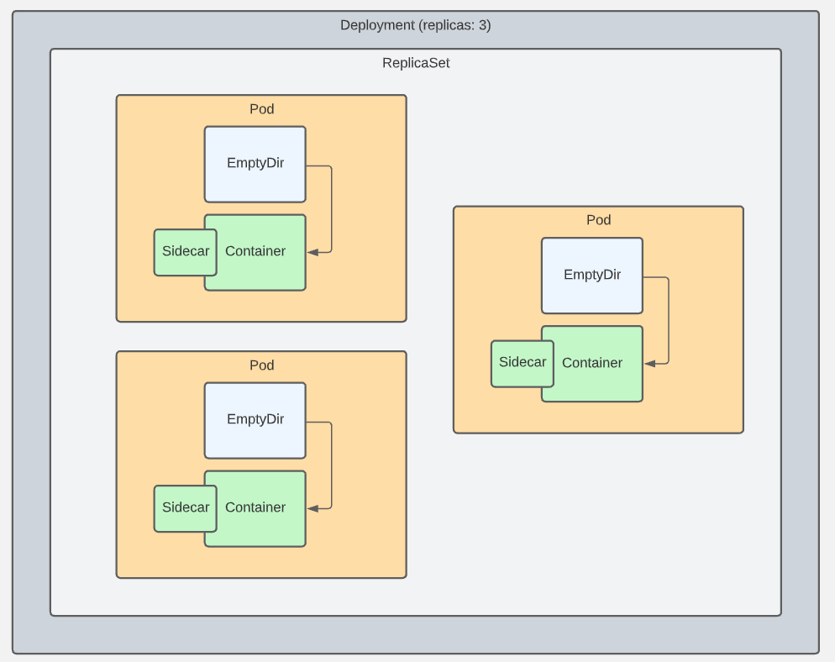
Pods, Deployments, & ReplicaSets

Slide 33
Question for the Group
This component is used in a Kubernetes cluster to store state about the cluster and the resources it is responsible for:
API server
Scheduler
etcd
Controllers
Type your choice in the chat…

Slide 34
Question for the Group
This component is used in a Kubernetes cluster to monitor current state against desired state, and notify the cluster when an update is required to resolve any gaps:
API server
Scheduler
etcd
Controllers
Type your choice in the chat…

Slide 35
Question for the Group
This component provides the programmatic interface to the Kubernetes cluster and is used by other components and users for retrieving data about the cluster and applying changes to the cluster:
API server
Scheduler
etcd
Controllers
Type your choice in the chat…

Slide 36
Control Plane: The API
The fundamental fabric of Kubernetes
RESTful API
Enables all communication between k8s components, and all operations they can do
Enables external user commands into the cluster

Slide 37
kubectl
kubectl (“kube-cuttle”) is command-line tool used to interact with API
May require installation (automatic if using k8s via Docker Desktop)
Config file defines details of connection to cluster (e.g., ~/.kube/config)
Run `kubectl cluster-info` to confirm connectivity
Run `kubectl` from command-line (with arguments) to see options
NOTE: k8s in Docker Desktop should handle most of this for you

Slide 38
Pod Configuration
Two types of pod: single container and multiple container
Making a single container pod is simple – use kubectl run
$ kubectl run <name of pod> --image=<name of the image from registry>

Slide 39
Pod Design Patterns
Usually, you will have one container per pod
There are cases when multi-container pods make sense: When both pods have the same lifecycle, or they MUST run on the same node.
An example: The primary container needs a helper process – it needs to be in the same node to be utilized.
There are three main patterns for multi-container pods:
Sidecar pattern
Adapter pattern
Ambassador pattern

Slide 40
Multi-container Pod: Sidecar Pattern
Main App plus a “helper” app that isn’t part of the main app
Example: Main app is a web app; helper is a logging utility

Slide 41
Multi-container Pod: Adapter Pattern
Used when you need to standardize output form various apps in the cluster
Each app type may format output in a unique way, but the cluster’s monitoring needs to work with standardized formats
Adding an adapter container to the pod for each app lets you still use the normal app output format in other areas, but have the cluster-level data work use a standardized format

Slide 42
Multi-container Pod: Ambassador Pattern
One more way to allow the pod’s containers to communicate with the outside world
Add an “ambassador” container to the pod that acts as a proxy for network traffic to and from the primary container
This lets you control traffic patterns based on the specific use case of the pod in question.
Example: database connection in dev/qa/prod environments

Slide 43
Azure Kubernetes Service (AKS)
Demo
Notes:
https://learn.microsoft.com/en-us/azure/aks/learn/quick-kubernetes-deploy-cli
Deploy an Azure Kubernetes Service cluster using the Azure CLI

Slide 44
Azure Kubernetes Service (AKS)

Slide 45
Azure Kubernetes Service (AKS)
What you might call a “semi-managed” offering in Azure
Enables stand up and use of a Kubernetes cluster in the Cloud
Includes a control plane and 1 or more work nodes (like standard k8s config we’ve been discussing)
The control plane is managed fully by Azure
The worker nodes are managed by you
AKS (i.e., the control plane) is free – you only pay for the worker nodes
Notes:
Review Azure Pricing Calculator costs for an AKS cluster

Slide 46
Azure Kubernetes Service (AKS)
Identity/Security Management
You can configure Kubernetes RBAC (Role-Based Access Control) to manage access and permissions for the k8s cluster
Supports direct integration with Azure Active Directory (AAD)
Existing users and groups (or new ones you create) can be granted access to the cluster for deploying workloads
For more advanced scenarios, a managed identity (service principal) can be assigned to your pods
Notes:
This managed identity allows control/management of access to other resources based on user, role, and group membership

Slide 47
Azure Kubernetes Service (AKS)
Additional Options Offered
Integrated logging and monitoring for cluster and workloads
Worker nodes in the cluster and pods can be configured to auto scale in response to increase or spikes in demand
Supports a rich upgrade capability – when deciding to upgrade cluster/nodes to new version of k8s, Azure will manage “in progress” traffic to completion to prevent service disruption during upgrade
An AKS cluster can be deployed into a virtual network in Azure, including assignment of an IP address from the pool of available addresses to each pod
Notes:
This enables pods to integrate with other pods in the cluster or other nodes in the virtual network

Slide 48
Azure Kubernetes Service (AKS) – RBAC
Demo
Notes:
https://learn.microsoft.com/en-us/azure/aks/azure-ad-rbac
Control access to cluster resources using Kubernetes role-based access control and Azure Active Directory identities in Azure Kubernetes Service

Slide 49
Azure Kubernetes Service (AKS)
Lab
Notes:
https://github.com/KernelGamut32/working-with-k8s-public/tree/main/labs/lab03
Deploying WordPress and MySQL

Slide 50
Diving Deeper into Kubernetes

Slide 51
Namespaces in k8s
Provide a grouping mechanism in Kubernetes
Every k8s object belongs to a namespace
Every Cluster automatically includes a default namespace

Slide 52
Namespaces in k8s
Allow you create logical separation within a physical Cluster
Provide a boundary for security and resource control
Can explicitly create a namespace and deploy resources to it using namespace field in manifest or --namespace arg on kubectl
Notes:
Could be used to separate by environment, by dev, by test area, or whatever

Slide 53
Namespaces in k8s
Objects within a namespace are isolated from others
Enables creation of multiple instances of same apps with same names
Resources from one namespace can communicate with another namespace using Services
Controller only looks for matching resources in its namespace

Slide 54
Contexts
Can be used to define connection details for a k8s Cluster
Sets the default namespace to be used
Prevents need to specify namespace – will use context to automatically set if excluded (like with default in standard install)
Able to switch between contexts using use-context command

Slide 55
Contexts
Can also be used to manage switching between different Clusters (local or remote)
For remote, API server will be secured with TLS and kubectl uses a client cert for AuthN

Slide 56
ConfigMaps vs. Environment Variables
A ConfigMap is an API object that lets you store configuration for other objects to use
These are key/value pairs
This lets you decouple environment-specific config data from your container images, making your apps more portable
CAUTION: ConfigMaps do not provide encryption or secrecy. Use a Kubernetes Secret for that.

Slide 57
ConfigMaps
Can be:
Set of key-value pairs
Blurb of text
Binary files
One pod can use many ConfigMaps and one ConfigMap can be used by many pods
Data is read-only – pod can’t alter

Slide 58
ConfigMaps as Env Vars
Can be created from a literal:
`kubectl create configmap <name> --from-literal=<key>=<value>`
Can be created from a file (to group together multiple settings):
`kubectl create configmap <name> --from-env-file=<file-path>`
Where <file-path> contains .env file like:
key1=value1
key2=value2
Can be created from a .yml definition file (like all things k8s)

Slide 59
ConfigMaps
Can be presented as files inside directories in the container
Uses volumes – making contents of ConfigMap available to pod
Uses volume mounts – loads contents of ConfigMap volume into specific container path in pod
Can contain settings to override defaults

Slide 60
ConfigMaps - Precedence
If env vars defined in multiple places, definitions in `env` section in pod spec will trump others (localized)
Typical approach:
Default app settings “baked in” to container image (e.g., to support dev mode)
Specific settings for an environment stored in ConfigMap and surfaced to container filesystem
Merges with default settings (overwriting where applicable)
Final tweaks can be accomplished with env variables in pod spec

Slide 61
Secrets in Pods
Secrets let you store and manage sensitive information, such as passwords, OAuth tokens, and ssh keys.
A pod needs to reference a secret. There are three ways get to the secret:
As a file in a Volume that is mounted to a container;
As an environment variable for a container;
By the kubelet, when it pulls images for the pod
NOTE: The default config for a Secret does NOT have encryption – data is plain text. You need to configure “Encryption at Rest” for the Secret”, and Role Based Access Control in your cluster

Slide 62
k8s Services
Services are an abstraction
They define a set of pods, and an access policy for them
A pod has an IP address
Pods are ephemeral – what happens to IP traffic if they die?
Pods in a service can have fixed IP addresses that stay the same even if the actual pod dies and is spun up again
Services are k8s objects; they are created like any other

Slide 63
k8s Service Types
ClusterIP (default): IP is internal to the cluster
NodePort: IP for the port is exposed with a static IP address
LoadBalancer: IP traffic to nodes is managed by external load balancer
ExternalName: IP traffic is routed by DNS Name (foo.example.com)

Slide 64
Cluster Access – Internal vs. External
You can access the cluster API using kubectl (“proxy”)
You can get libraries for popular languages that can access the cluster
k8s objects (pods) can also access the API internally
This uses an internal DNS
“kubernetes.default.svc” maps to the API server
The pod usually uses a “sidecar” container to do this

Slide 65
Container File System
Each container in a pod has its own filesystem built by k8s
Can be built from multiple sources, including:
Layers from the container image
Writable layer for the container
Can be expanded with other sources like ConfigMaps and Secrets – mounted to a specific path in a container
Volumes can provide another source of storage – volumes are defined and mounted to containers

Slide 66
EmptyDir
Empty directory stored at pod level vs. container level
Mounted as a volume into the container so visible there
Any data stored there from the container remains in pod between restarts
Replacement containers can access data from predecessors

Slide 67
HostPath
Data physically stored on node in cluster
Extends beyond lifecycle of pod
Available to replacement pods (but only if run on same node)
Mounted as a volume into the container like others
However, can have issues:
In cluster with multiple nodes, limits usefulness
If not careful, can expose large blocks of host data

Slide 68
PersistentVolume
Like pods (abstraction over computer) and services (abstraction over network), persistent volumes provide abstraction over storage
k8s object that defines available section of storage
Can be “mapped” to shared storage (like NFS) or locally (for dev/test purposes)

Slide 69
PersistentVolumeClaim
Pods are not allowed to use persistent volumes directly
Instead, pods claim using PersistentVolumeClaim object type in k8s
Requests storage for a pod
k8s handles matching up a claim to a persistent volume
Provides virtual storage abstracted from actual storage

Slide 70
Dynamic Provisioning
Static provisioning accomplished by explicitly creating persistent volume and then claim (k8s binds claim to volume)
Dynamic provisioning supported as well
You create the persistent volume claim and let persistent volume be created on demand by cluster
Can leverage storage classes for defining and matching types of storage

Slide 71
Storage Classes
Defined by three properties:
provisioner – component that creates persistent volumes on demand
reclaimPolicy – what to do with dynamically created volumes when claim is deleted
volumeBindingMode – eager vs. lazy binding/creation (at same time as claim creation or only when pod using the claim get created)
Also, able to create custom storage classes defined by same properties

Slide 72
Scaling k8s
Manage
Manage
Deployments
ReplicaSets
Pods
Containers
Manage

Slide 73
Setting Limits in Deployments
When defining pod spec in deployment, can use limits to manage
`resources` attribute defines compute resource requirements for pod
`limits` can be used to apply limits (e.g., in amount of memory and cpu)
Usually better to optimize once running vs. prematurely optimizing
Target environment when running will help determine correct settings

Slide 74
DaemonSets
daemon is usually a system process that runs constantly as single instance
In k8s, DaemonSet runs single replica of a specific pod on every node in cluster
Usually used for infrastructure-level concerns:
Logging/central data collection
High availability for a reverse proxy running in cluster
Looks similar to other controllers (e.g., Deployment) but no replica count

Slide 75
Using DaemonSets in Deployments
Control loop watches for nodes joining cluster
New pod instance for the daemon will be started on new node
Works to stop/remove daemon pod(s) if node(s) taken out of cluster

Slide 76
Using DaemonSets in Deployments
Can also target just a subset of nodes for daemon pod
As with most other things in k8s, use label matching
Watches for nodes join cluster and for metadata matching label
DaemonSet control loop is different from ReplicaSets because has to monitor combo of node activity and pod count

Slide 77
StatefulSets
Represents a Pod controller that enables running apps at scale in a predictable manner
Deployments/ReplicaSets create Pods with random names
Also, starts Pods in parallel
Some use cases (e.g., clustering) require a more deterministic approach

Slide 78
StatefulSets
For example, creating a cluster of PostgreSQL instances
With StatefulSets, can create Pods with predictable names
Can access the Pods individually over DNS
k8s will start the Pods in sequence

Slide 79
StatefulSets
With a PostgreSQL cluster, able to earmark a Pod as primary
Other Pods will wait for the primary and can use primary for replication
Allows clustering of multiple database instances with read-replicas
Pod name will be StatefulSet name followed by an index (starts at 0)

Slide 80
StatefulSets
Provides stability for the deployment
Replacement of missing Pods will respect this ordering
If Pod 0 goes down, a replacement Pod 0 will be created (with same config)
Other Pod indexes will stay in place

Slide 81
StatefulSets
To get access to DNS names for individual Pods, create a “headless” service
Create the service with a clusterIP of None
Does not use fixed IP for the Service
DNS entry for the service returns an IP address for each Pod in the StatefulSet
Each Pod gets its own DNS entry as well

Slide 82
StatefulSets
Can require adjustment to data storage approach
With something like PostgreSQL, each database instance will write data in its own writable layer instead of a shared location
Cannot simply mount a standard PVC for data storage as every Pod would try to write to that volume shared across all Pods

Slide 83
StatefulSets
StatefulSet specification provides a volumeClaimTemplates field
Can include storage class, capacity, and access mode definitions
Each Pod in the spec gets its own dynamically-created PVC
As previously discussed, creates PersistentVolumes for each using defined storage class (or default in not specified)
This link between Pod and PVC remains in place even across Pod replacement

Slide 84
StatefulSets
Keep in mind – StatefulSets are intended to provide a stable and predictable deployment environment
Less flexible than other controller types
Can make changes more impactful
Be sure app requirements fit model

Slide 85
Jobs
Provide options for running maintenance tasks in your k8s Cluster
For example, with PostgreSQL cluster from previous, can schedule tasks against the DB “out-of-band”
Tasks like backing up databases, data migration, data loads, etc.
Defined with a Pod spec and run to completion as a batch process

Slide 86
Jobs
Can run Pods for any container image but should represent a process with a discrete end (intended to run to completion)
Jobs add labels to the underlying Pods created
Includes a completions property for specifying how many times the Job should run

Slide 87
Jobs
And a parallelism property for specifying how many Pods to run in parallel
Enables distribution of Job processing for multiple types/instances across the Cluster
Also, can assist with managing the speed of Job execution

Slide 88
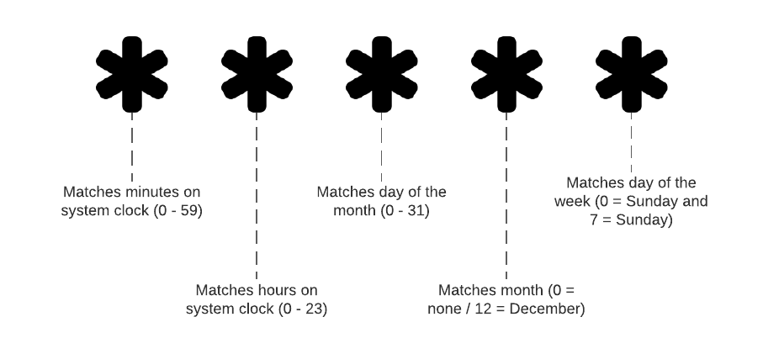
CronJobs
Specific type of Job for executing regularly and on a schedule
Allows definition of a Job spec for use by CronJob for Job creation on the defined schedule
Use the Linux Cron format

Slide 89
CronJobs
Can move CronJobs to suspended state
Logic needs to account for standard Pod lifecycle management
Could include restarts or parallel runs – logic needs to support
Notes:
Leaves in place but won’t run again until reactivated

Slide 90
Startup Probes
First probe executed on startup and determines if app is initialized and ready for traffic
Only runs on initialization – once complete, will not run again in the Pod
Can specify number of probe attempts (failureThreshold)
And number of seconds to wait between retries (periodSeconds)
If all defined attempts fail, k8s will kill the Pod and startup a replacement

Slide 91
Readiness Probes
k8s knows if Pod container is running but not if application inside is healthy (specific to the app)
Defined in the Pod spec
Execute health checks on a fixed schedule

Slide 92
Readiness Probes
Act at the network level and manage routing for listening components
If deemed unhealthy, Pod will be taken out of ready state and removed from list of active Pods
k8s keeps running probe looking for Pods that have recovered for reassociation to the Service
Different types of probes are supported – e.g., HTTP GET for web apps

Slide 93
Liveness Probes
Use same health checks as readiness probes
Action on failure is different
Act at compute level and restart unhealthy Pods
Different types of probes are supported – e.g., HTTP GET for web apps

Slide 94
Managing Logs
k8s collects logs from container runtime and stores as files on node
Goal is to get logs out of the container and potentially centralize for aggregated processing
Often uses a sidecar container for the aggregation

Slide 95
Managing Logs
Logs can benefit from normalization
Parsing can be applied as the information passes through the pipeline
Several 3rd party tools (e.g., Fluentd for log collection, Elasticsearch for log storage, and Kibana for view)

Slide 96
Deploying and Scaling Clusters
Clusters can scale as needed
Increased load
Rolling cluster updates
This is often managed by the cloud provider with cloud native

Slide 97
Managing Cluster Resources
Container limits provide options for specifying limits at the container level
Allow specification of memory and cpu limits to prevent a container from exhausting cluster resources
Can be defined using “requests” and “limits” in container spec
“requests” define what is requested (like a minimum) – container can use more than what’s defined if node provides
“limits” are hard stops – if exceeded container will be replaced

Slide 98
ResourceQuota
Also, able to apply resource limits at the namespace level
Pod specs need to include a resource section
Container limits are reactive; ResourceQuotas are proactive
Pods won’t be created if they would exceed limit

Slide 99
The Ingress Controller
Specialized load balancer for k8s environments
Manages traffic to pods in your cluster
Like Nodes, Services etc., they are deployed using the cluster API
There are several available besides the k8s offering

Slide 100
Rolling Deployments
Code changes, so your pod (containers) change
We want a stable experience for users
k8s does this via rolling deployments
As updates nodes become available, traffic is load balanced to ensure uptime

Slide 101
Blue/Green Deployments
How they work: keep two identical environments, conventionally called blue and green, to do continuous, risk-free updates. This way, users access one while the other receives updates.
With bare metal servers, this is expensive – one of the environments isn’t used much when the other is
k8s makes this easy – we can make a second environment, switch traffic over, then kill the first with little impact

Slide 102
Canary Pods for Testing and Production
A strategy to try out a new feature only for a small segment of users or traffic (A/B testing)
k8s makes this easy
Use a tag to designate what pods will receive a small percentage of traffic
Also, allows smoke testing on small scale before “opening floodgates”

Slide 103
NetworkPolicy and SecurityContext
NetworkPolicy can be used to manage access within a Cluster
Work like firewall rules and use label selectors for blocking traffic
Provides ingress rules and egress rules to manage flow
Rely on network implementation in Cluster for enforcement
Notes:
Not every network plugin will support – be aware

Slide 104
NetworkPolicy and SecurityContext
SecurityContext provides an option for container security
Alternative to containers running as root or super user account
Offers more fine-grained control than at Pod level, enabling explicit addition and removal of Linux kernel options
Must remain aware of potential breaks in apps caused by security config

Slide 105




Thank you!
If you have additional questions, please reach out to me at:
(email address)
Notes:
Mandatory -- Need bookend -- first and last thing they should see is DevelopIntelligence
ACTION: Use this for the final slide of your class materials. Include contact information so participants can reach you if they have questions after the course.

